Slide 1
The convergence of Finance, Health & Technology
Becky Inkster
Notes:
1. Im going to skip affiliations etc and tell you about how I ended up here
2. So my journey into this space started with the art world

Slide 2
Today is about…
opening up dynamic discussions exploring innovation across finance, health and technology in order to move toward more holistic, personalised ways to best serve individual needs and preferences.
There will be an emphasis on data science, with a balancing act between measured optimism and data ethics to steer us away from questionable practices.
Notes:
This community-building event brings together experts across health, finance, technology, policy, and data science to discuss future directions for combined health and wealth management. The event opens with a clear agenda, introductions, and speakers sharing their visions and experiences in this space. It is followed by a panel & audience discussion and then a closed Roundtable to further scope opportunities and risks. The overall goal of this event is to generate a first-step Scoping Report and to map out possible future steps.

Slide 3
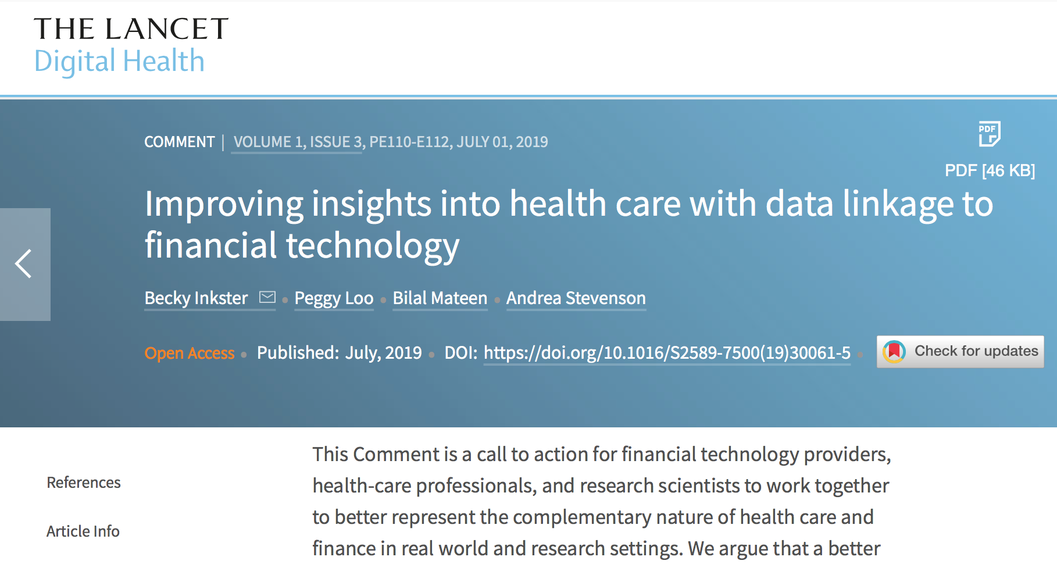
A dearth of evidence-based research on relationship between ‘finance and health’
3,971,592 citations for ‘cancer’ only 90 for ‘cancer and debt’
83,943 citations for ‘suicide’ only 54 citations when combined with ‘debt’
Similar disparities exist for other health terms combined with money-related term
Notes:
Cancer & Money 1095

Slide 4
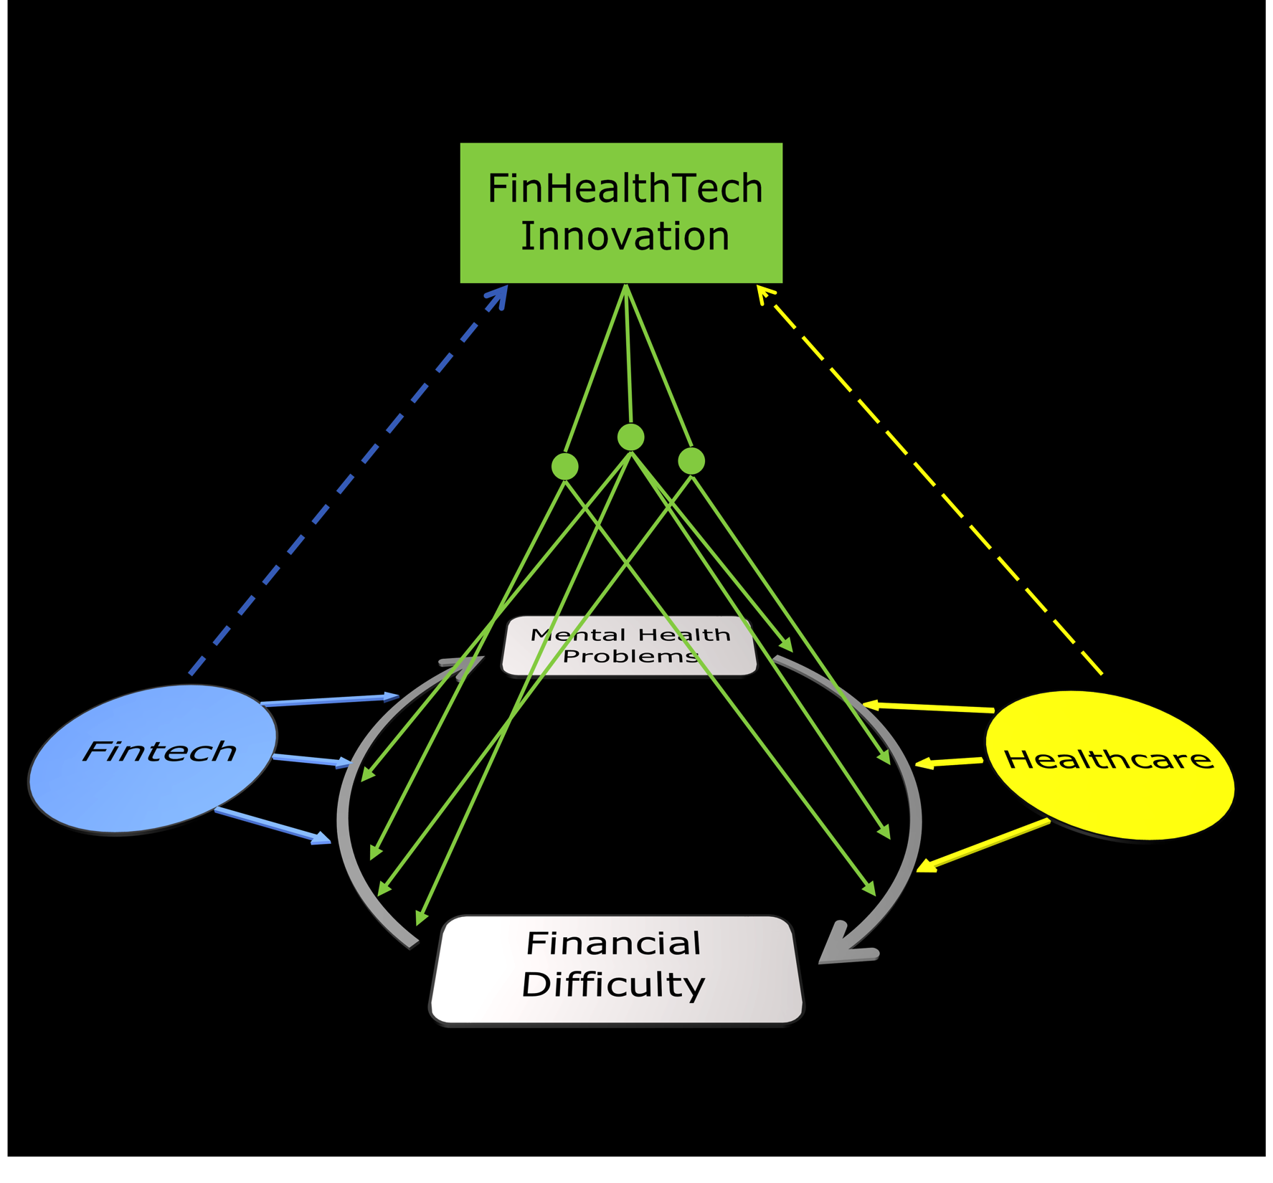
Inkster et al., unpublished

Slide 5
COMMITMENT
FHT Consortium
FHT Conference
FHT Book

Slide 6
“ I still feel like I have to chose between financial independence and health”
– Anonymous

