Slide 1
HIP-HOP is the
MOST POPULAR GENRE
IN THE WORLD
REGARDLESS OF LANGUAGE OR LOCATION
ACCORDING TO A SPOTIFY ANALYSIS OF
20 BILLION TRACKS

Slide 2
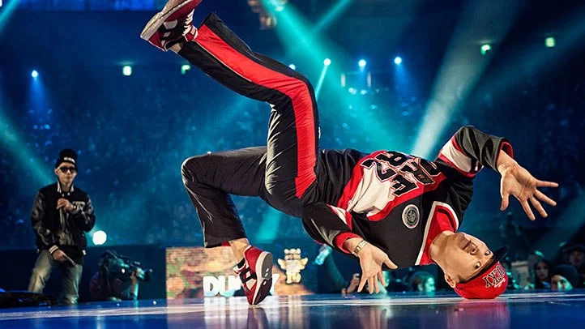
It’s also...
Lyrics
Dance
Art
Music
Notes:
Add image.

Slide 3
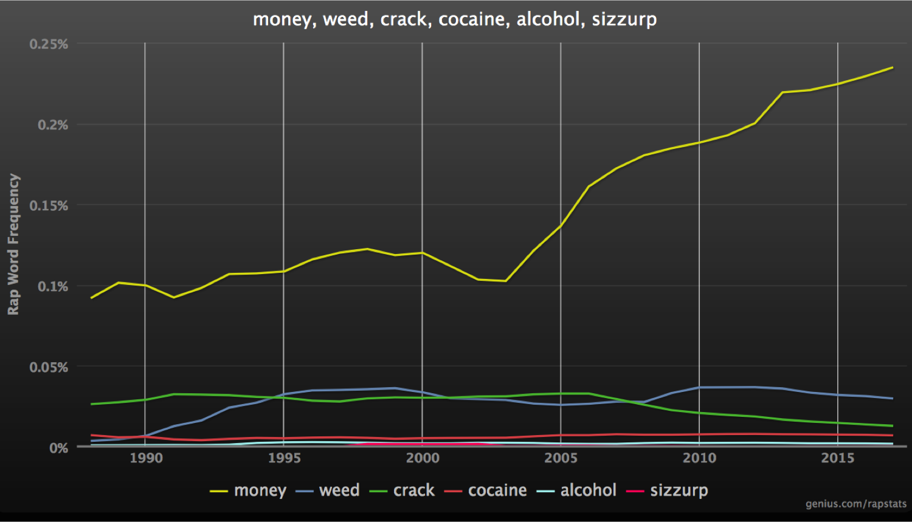
"Money” in rap lyrics
1990 - 2015

Slide 4
The UK has one of the lowest levels of financial literacy in developed nations.
In a 2018 study* British young people performed particularly poorly on the financial test, compared to their peers in other developed countries..
*source: https://johnjerrim.com/piaac/
Notes:
the UK has one of the lowest financial literacy levels amongst developed nations
https://www.ucl.ac.uk/ioe/news/2018/mar/england-has-one-lowest-levels-financial-literacy-study-says “England has one of the lowest levels of financial literacy, study says” Published 15th March 2018, by Bhutoria A, Jerrim J, Vignoles A.

Slide 5
RADICAL SOLUTION
Artists talk about money, financial resilience and entrepreneurship.
Young people relate to their words.

Slide 6
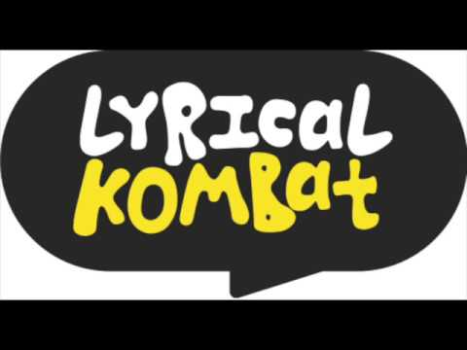

Slide 7
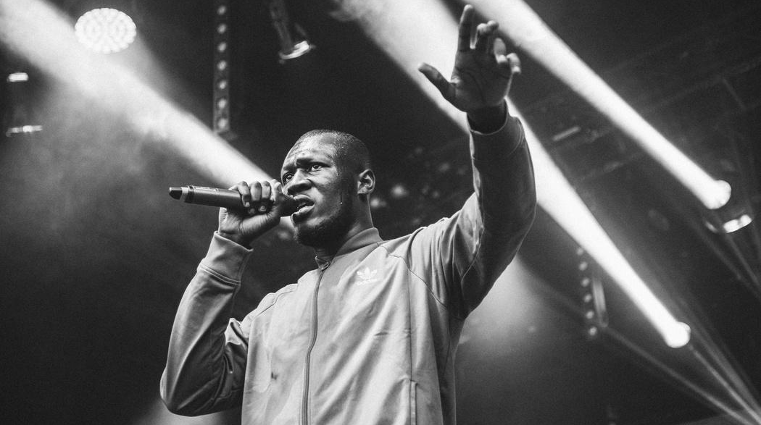
LYRICAL KOMBAT
Financial themed challenges based on lyrics
Challenges earn points and rewards
Leaderboards and competitions
Tools to build financial data skills
Notes:
Quiz

Slide 8
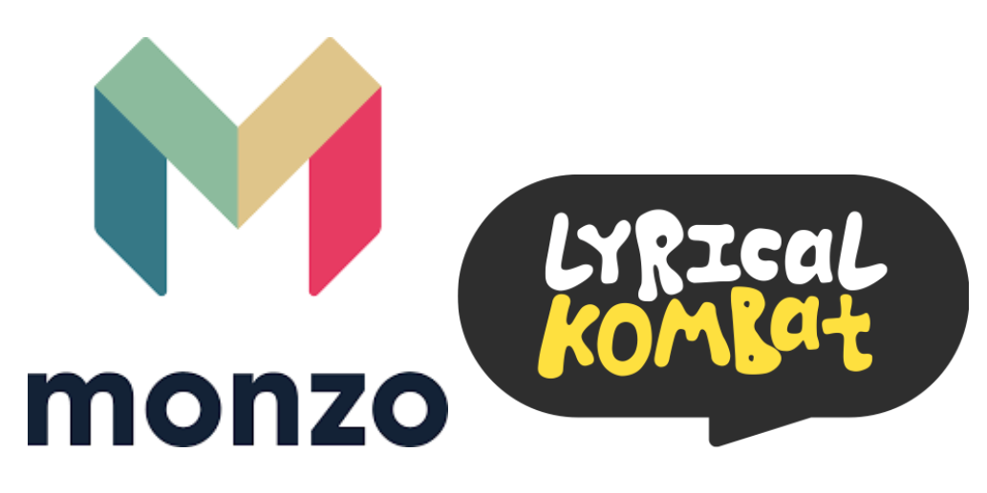
OUR PROJECT
Themed lyrical challenges to build financial vocabulary.
Leverage popularity of artist for financial learning.
Offer data skills tutorials as support (partnerships)
Reward audience for their progress

Slide 9
WHY DO IT?
New way to engage a younger audience with financial literacy.
Create engagement around hard topic using deeply personal content.
Experimental yes, but given what’s at stake a radical approach is needed.

Slide 10
THANK YOU

